Slide 1



SRM INSTITUTE OF SCIENCE AND TECHNOLOGY
18CSC201J – Data Structures and Algorithms
Unit III- STACK & QUEUE

Slide 2
SESSION 8

Slide 3
Queue Representations
Queues can be represented using:
Arrays
Linked Lists

Slide 4
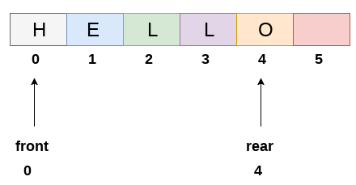
Array Implementation of Queues
Queue can be implemented using a one-dimensional array.
We need to keep track of 2 variables: front and rear
front is the index in which the first element is present
rear is the index in which the last element is present
https://www.javatpoint.com/array-representation-of-queue

Slide 5
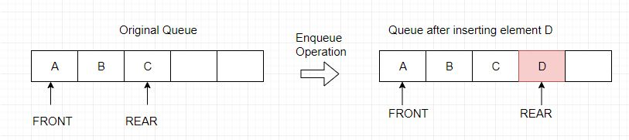
Enqueue in Array Implementation of Queue
//Basic Idea
enqueue(num):
rear++
queue[rear]=num
return
Time Complexity: O(1)

Slide 6
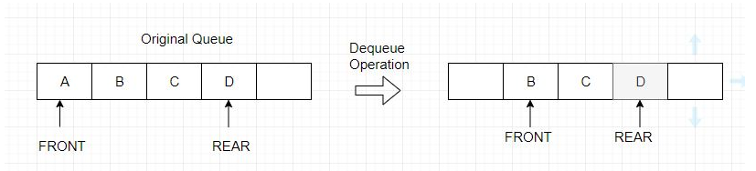
Dequeue in Array Implementation of Queue
//Basic Idea
dequeue():
num = queue[front]
front++
return num
Time Complexity: O(1)
O(n) if elements are shifted

Slide 7
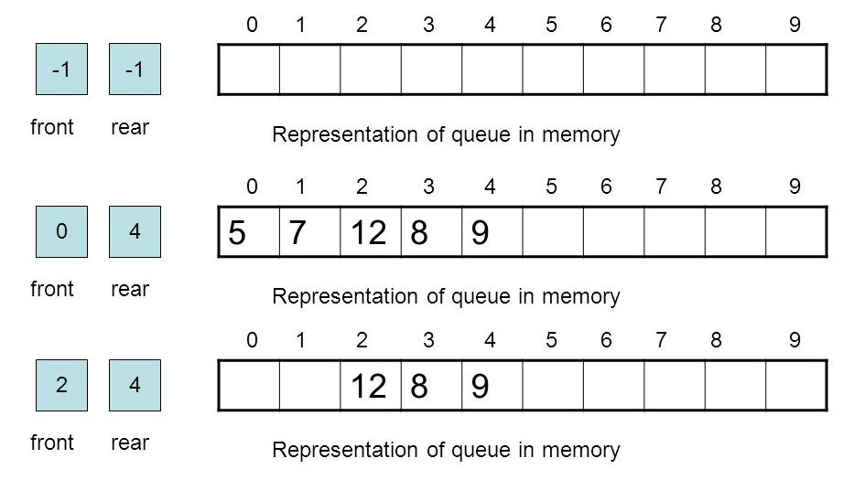
Enqueue and Dequeue in Queue
Image Source: https://slideplayer.com/slide/4151401/

Slide 8
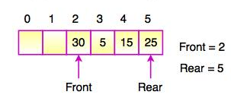
Disadvantage of Array Implementation of Queue
Multiple enqueue and dequeue operations may lead to situation like this:
No more insertion is possible (since rear cannot be incremented anymore) even though 2 spaces are free.
Workaround: Circular Queue, Shifting elements after each dequeue
https://www.tutorialride.com/data-structures/queue-in-data-structure.htm

Slide 9
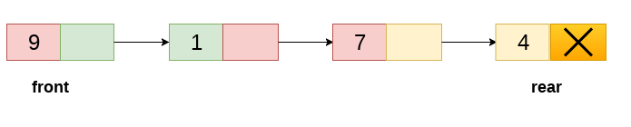
Linked List Implementation of Queue
In the linked list implementation of queue, two pointers are used, namely, front and rear
New nodes are created when an element has to be inserted.
Each node consists of queue element and a pointer to the next node

Slide 10
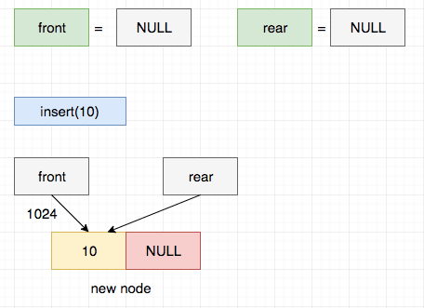
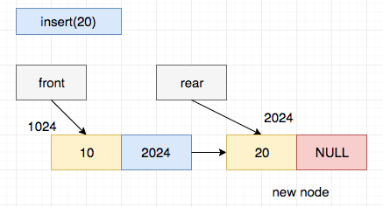
Enqueue Operation in Linked List Implementation of Queue
Enqueue basic code:
Time Complexity: O(1)
ptr -> data = item;
rear -> next = ptr;
rear = ptr;
rear -> next = NULL;
Image Source: https://www.log2base2.com/data-structures/queue/queue-using-linked-list.html

Slide 11
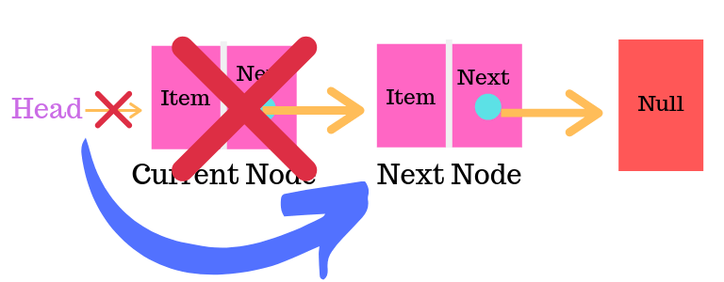
Dequeue Operation in Linked List Implementation of Queue
Dequeue basic code:
Time Complexity: O(1)
ptr = front;
front = front -> next;
free(ptr);
Rear
Front
Image Source: https://learnersbucket.com/tutorials/data-structures/implement-queue-using-linked-list/

Slide 12
References
Seymour Lipschutz, Data Structures, Schaum’s Outlines, 2014.

